Slide 1
CRYPTOCURRENCY
Twitter Analysis
By Michael Cuffaro
Disclaimer: I am not a financial institution nor do I represent one. All that I am providing is educational material: Do not take this information as professional investment advice.

Slide 2
Introduction
What Will This Project Deliver?
Insight into tweet attributes that may impact Bitcoins price movements
Machine Learning modeling to predict Bitcoins price movements
Insight into important words that may trigger an up or down movement in price over 15 & 30 minute windows
Disclaimer: I am not a financial institution nor do I represent one. All that I am providing is educational material: Do not take this information as professional investment advice.

Slide 3
Introduction ^{(Cont’d)}
Which Cryptocurrencies Will Be Included?
Bitcoin
How Will Analysis Be Performed?
Analysis will be performed with Python
Python packages utilized:
NumPy, Pandas, Vader Sentiment Analyzer, Textblob Sentiment Analyzer, NLTK, Regular Expressions, CountVectorizer, Seaborn, Matplotlib, Sklearn
Where to Retrieve Project Code?
GitHub (Link: https://github.com/mlight9/...)
Disclaimer: I am not a financial institution nor do I represent one. All that I am providing is educational material: Do not take this information as professional investment advice.

Slide 4
Data Collection
Tweets | How: | Twitters Streaming API
 | When: | 3/1/2018 to 3/14/2018
 | Number of Tweets: | ~ 3.6 Million
 | Tweet Attributes: | Time Stamp Raw Text Language Number of Times Favorited Number of Followers
Bitcoin | How: | Bitcoin Charts
 | Bitcoin Attributes: | Open & Close Price High & Low Price Trading Volumes

Slide 5
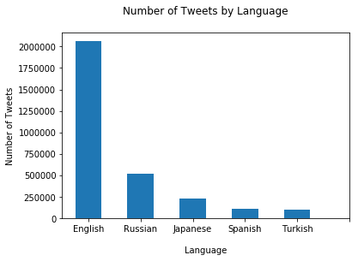
Top Five Languages
~ 2.06 Million
~ 520,000
~115,000
~ 230,000
~100,000

Slide 6
Sentiment Classification
Algorithms to Analyze & Classify Tweets
Vader Sentiment Analyzer
TextBlob Sentiment Analyzer
How Were Algorithms Tuned?
Using 10,000 general classified tweets (ThinkNook)
Varying a threshold (i.e., If tweet polarity > threshold, tweet is +)
Performance Metrics: Accuracy & number of samples thrown away (neutral tweets)

Slide 7
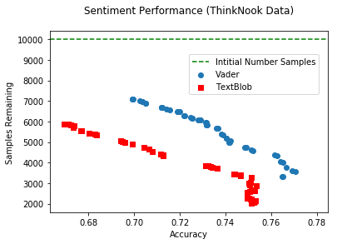
Vader & TextBlob Tuning
Which Sentiment Analyzer Performs Best?
Optimal Model Selection
Vader is best performer
Based on maximizing number of samples (6171)
Using threshold (.2) that yields with an accuracy of .725

Slide 8
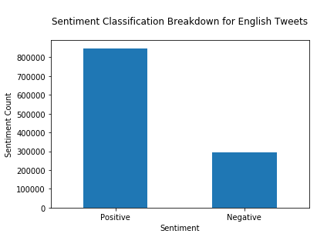
Optimal Sentiment Analyzer
Running 2.06 Million English Bitcoin Tweets Through Vader, We Get:
Overall Sentiment for Bitcoin is Positive (3/1/2018 - 3/14/2018)

Slide 9
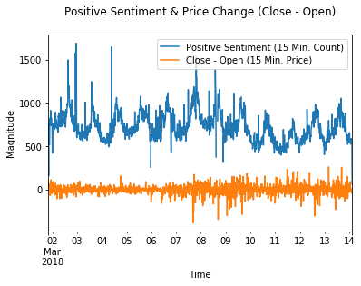
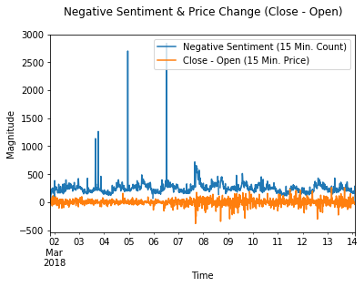
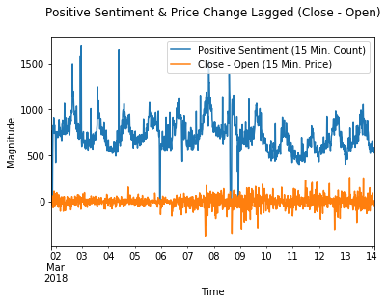
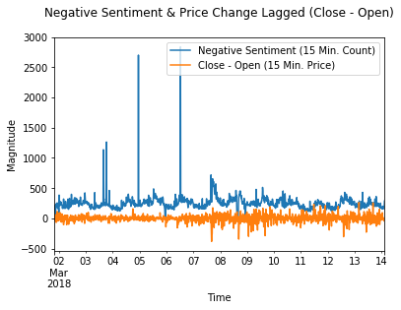
Investigating Sentiment & Price Change Movements
15 Min.
Close
-
Open
15 Min. Lag
Close
-
Open
Disclaimer: I am not a financial institution nor do I represent one. All that I am providing is educational material: Do not take this information as professional investment advice.

Slide 10
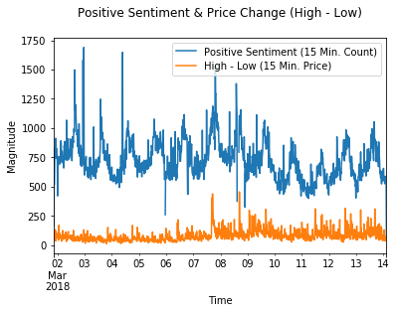
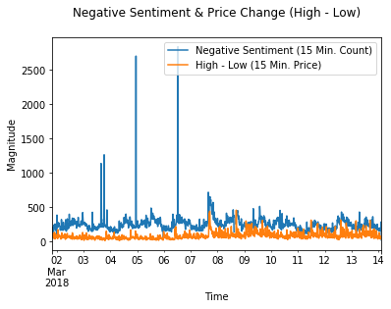
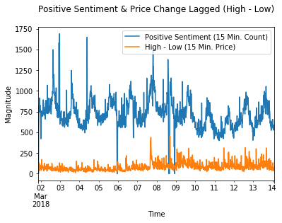
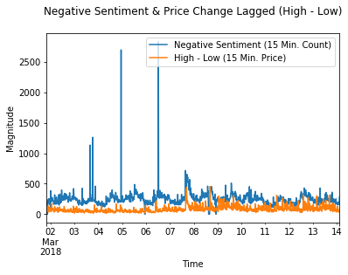
Investigating Sentiment & Price Change Movements
15 Min.
High
-
Low
15 Min. Lag
High
-
Low
Disclaimer: I am not a financial institution nor do I represent one. All that I am providing is educational material: Do not take this information as professional investment advice.

Slide 11
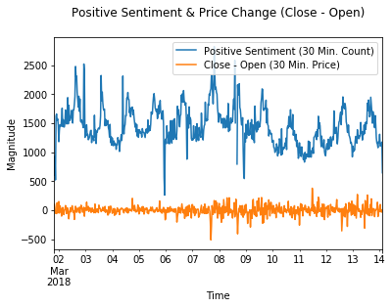
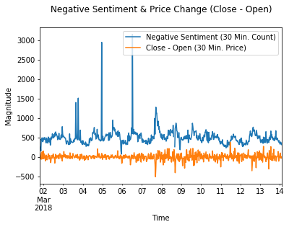
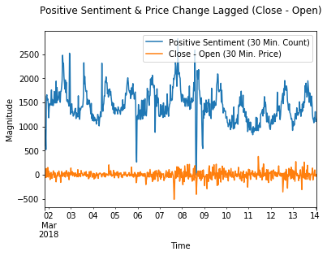
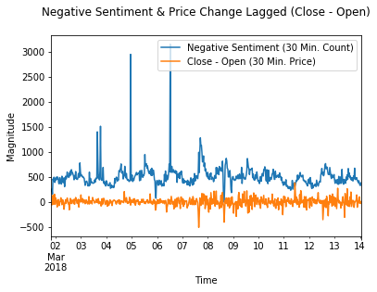
Investigating Sentiment & Price Change Movements
30 Min.
Close
-
Open
30 Min. Lag
Close
-
Open
Disclaimer: I am not a financial institution nor do I represent one. All that I am providing is educational material: Do not take this information as professional investment advice.

Slide 12
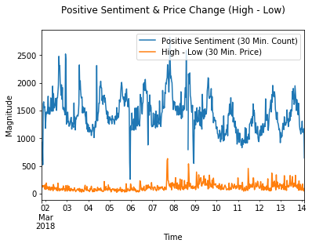
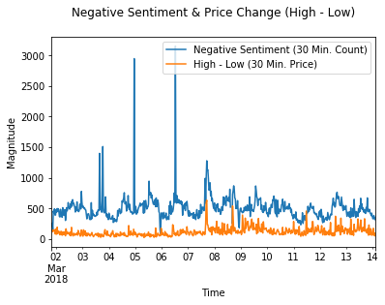
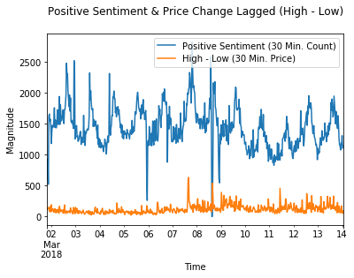
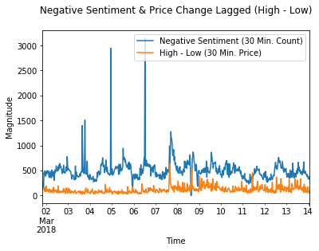
Investigating Sentiment & Price Change Movements
30 Min.
High
-
Low
30 Min. Lag
High
-
Low
Disclaimer: I am not a financial institution nor do I represent one. All that I am providing is educational material: Do not take this information as professional investment advice.

Slide 13
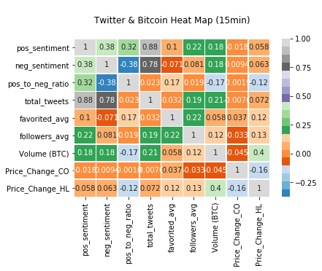
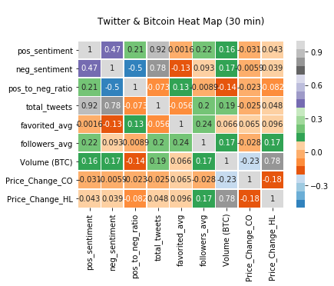
Investigating Pearson Correlation
Looking Beyond Sentiment & Including All Tweet and Bitcoin Attributes Collected:
15 Minute Window Lagged
30 Minute Window Lagged
Disclaimer: I am not a financial institution nor do I represent one. All that I am providing is educational material: Do not take this information as professional investment advice.

Slide 14
Sentiment Analysis Approach Lookback
Vader & Text Blob Sentiment Analyzer
Lexicon based approaches to Sentiment Classification
Great for cases where don’t have training data (no humanly labeled data saying a tweet is + or - )
Since Lexicon is pre-defined, it may not perform optimally on domain specific problems
i.e., Financial Jargon might not be present in Lexicon or not ‘understood’ contextually resulting in sentiment misclassification
For our case: Substantial number of samples thrown away most likely because of no lexicon matches (~50 % of data classified as neutral, which is the default when classifier is ‘confused’)
All lowercase words were used; emoji’s, stems and lemmas were not used for analysis
Better Approach
Supervised learning classification methods
Allow for training/learning on domain specific jargon
Next steps: Humanly label data and classify sentiment with state of the art algorithms like FastText
Disclaimer: I am not a financial institution nor do I represent one. All that I am providing is educational material: Do not take this information as professional investment advice.

Slide 15
Machine Learning Overview
Goal
Classification problem with a goal of predicting, within 15 & 30 minute intervals, if Bitcoin’s price will increase or decrease
Feature Composition
Words tokenized form tweets with n-gram range (1-4) generated by CountVectorizer
Tweet attributes (i.e., total number of tweets, number of times favorited, number of followers, ration of positive to negative tweets)
Bitcoin attributes (i.e., trading volume)
Best Overall Model
Determined with GridSearchCV & Area Under ROC Curve
Models Being Investigated
Logistic Regression
Random Forest
Disclaimer: I am not a financial institution nor do I represent one. All that I am providing is educational material: Do not take this information as professional investment advice.

Slide 16
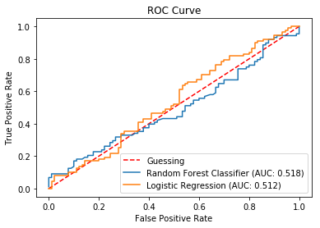
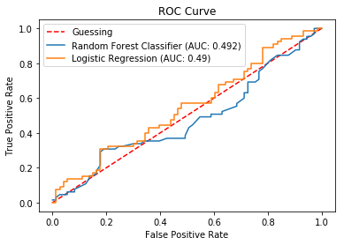
Performance of Models
Target: Open – Close
15 Minute Window Lagged
30 Minute Window Lagged
Disclaimer: I am not a financial institution nor do I represent one. All that I am providing is educational material: Do not take this information as professional investment advice.

Slide 17
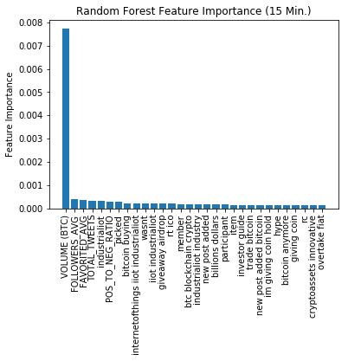
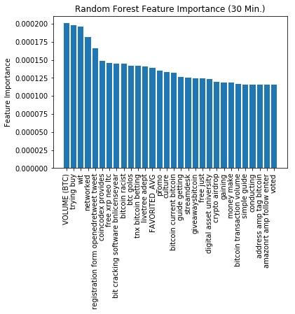
Top 30 Features – Random Forest
Target: Open – Close
Word Features: Lowercase
15 Minute Window
30 Minute Window
Disclaimer: I am not a financial institution nor do I represent one. All that I am providing is educational material: Do not take this information as professional investment advice.

Slide 18
Machine Learning Lookback
Pearson Correlation
Evident that slightly more signal was picked up over 15 minute window (comparing heat-maps) to predict price movements
Machine Leaning
Overview
Random Forest Classifier & Logistic Regression
75 – 25 split for training and testing
Models limited to 10,005 features due to computational limits of local machine
Features composed of words from tweets (emoji's were stripped) & price data for Bitcoin
Performance
Model performance evaluated with GridSearchCV & Area Under ROC
Random Forest attained maximum AUC of .518 over 15 minute window
Verdict
At this point in time, models offer weak advantage over guessing, further research warranted!
Disclaimer: I am not a financial institution nor do I represent one. All that I am providing is educational material: Do not take this information as professional investment advice.

Slide 19
Road Ahead
Collect twitter data for extended period of time (i.e., more than 2 weeks)
Investigate and integrate alternate news sources into analysis
Include emoji’s in sentiment classification and as tokenized features
Emoji's are structured and universal, allowing for screening of tweets in all languages
Further investigate feature lag on different time scales to predict up or down movements
Combine multiple machine learning models and use majority voting to increase stability in predictions
Disclaimer: I am not a financial institution nor do I represent one. All that I am providing is educational material: Do not take this information as professional investment advice.

